Slide 1
Used Car Price Prediction Analysis
Machine Learning Models

Slide 2
Introduction
In this project, we aim to find the best regression model for dataset in order to be able to predict used cars prices.
We have used our own dataset and scrapped it. It contains 3000 used cars and 6 features.
Original dataset had plenty missing values, outliers and mistakes, to be able to work on it we had to clean, impute and change their format.
We select the features carefully and extract new features from raw data.
In order to achieve this goal we used Extra tree Regreassor, XGBoost Regressor, Catboost Regressor and Random Forest, processed and analyzed the results which will be further presented in the upcoming slides.

Slide 3
Data Preparation
Name : We have used car manufacturing company name.
Price : the price on the advert to sell the car, This is the dependent variable in all of the upcoming models.
Year : The car model’s year
Mileage : The efficiency of the car.
Engine : Which type of car engine used fuel like Petrol or Diesel.
Transmission : How the car features are unique.

Slide 4
Identify null values
There is column named transmission in our dataset in which missing values are present.
The rows with null values are small and look inconsistent, so it is best we delete it.
12 rows have been deleted which is less than approx 1% of the total data.

Slide 5
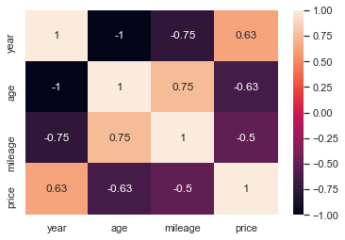
Exploratory Data Analysis
We used correlation matrix first.
And shown via heatmap.

Slide 6
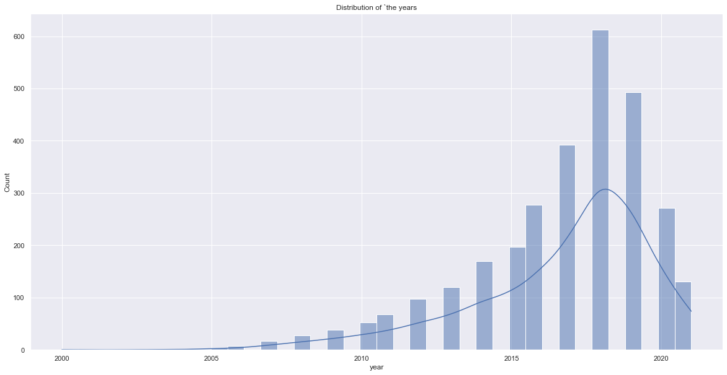
Exploratory Data Analysis
We also used histplot diagram to show the he distribution of cars as per year wise collection.

Slide 7
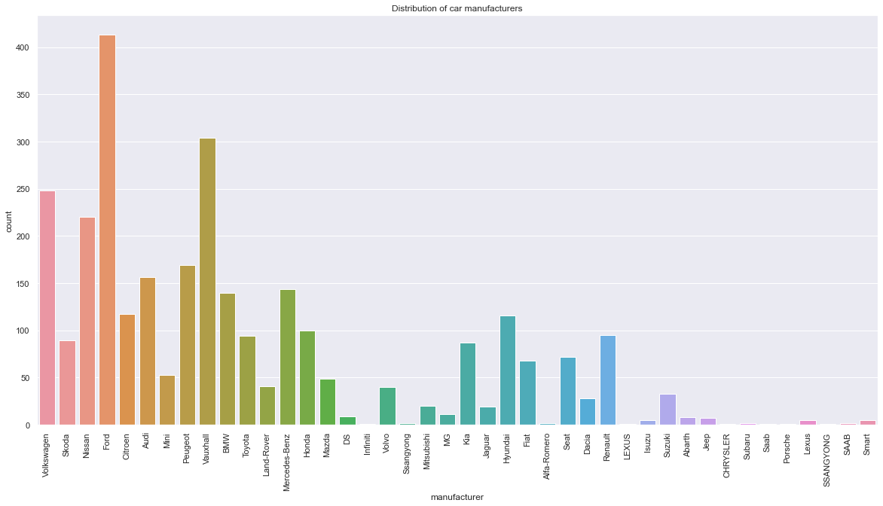
Exploratory Data Analysis
We also used count plot to show the total no. of cars manufactured by the car company.

Slide 8
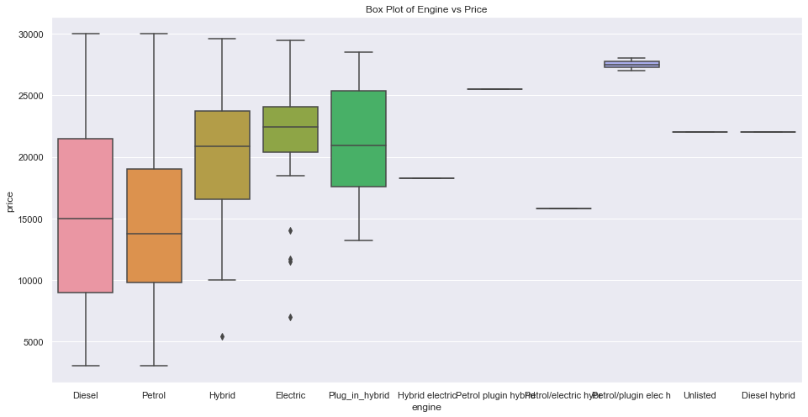
Pre-processing
In order to get a better understanding of the data, we plotted a boxplot of the data. We noticed that the dataset had many outliers, primarily due to large price sensitivity of used cars.
models that are the latest year and have low mileage sell for a premium, however, there were many data points that did not conform to this.

Slide 9
Methodology
Random Forest
Random Forest is an ensemble learning based regression model. It uses a model called decision tree, specifically as the name suggests, multiple decision trees to generate the ensemble model which collectively produces a prediction.
The benefit of this model is that the trees are produced in parallel and are relatively uncorrelated, thus producing good results as each tree is not prone to individual errors of other trees.
This model was hence chosen to account for the large number of features in the dataset and compare a bagging technique with the following gradient boosting methods.

Slide 10
XGBOOST
Extreme Gradient Boosting or XGBoost [4] is one of the most popular machine learning models in current times.
XGBoost is quite similar at the core to the original gradient boosting algorithm but features many additive features that significantly improve its performance such as built in support for regularization, parallel processing as well as giving additional hyperparameters to tune such as tree pruning, sub sampling and number of decision trees.

Slide 11
LightGBM
Light GBM [5] is another gradient boosting based framework which is gaining popularity due it higher speed and accuracy compared to XGBoost or the original gradient boosting method.
This framework can also handle categorical features [6], thus eliminating the need to one hot vectorize them and in turn, reducing memory usage.

Slide 12
CATBOOST
Cat Boost is a recently open-sourced machine learning algorithm from Yandex. It can easily integrate with deep learning frameworks like Google’s TensorFlow and Apple’s Core ML.
It can work with diverse data types to help solve a wide range of problems that businesses face today. To top it up, it provides best-in-class accuracy.
It is especially powerful in two ways:
It yields state-of-the-art results without extensive data training typically required by other machine learning methods, and
Provides powerful out-of-the-box support for the more descriptive data formats that accompany many business problems.

Slide 13
Extra Tree Regressor
An extremely randomized tree regressor.
Extra-trees differ from classic decision trees in the way they are built. When looking for the best split to separate the samples of a node into two groups, random splits are drawn for each of the max_features randomly selected features and the best split among those is chosen.
An extra-trees regressor. This class implements a meta estimator that fits a number of randomized decision trees (a.k.a. extra-trees) on various sub-samples of the dataset and uses averaging to improve the predictive accuracy and control over-fitting.

Slide 14
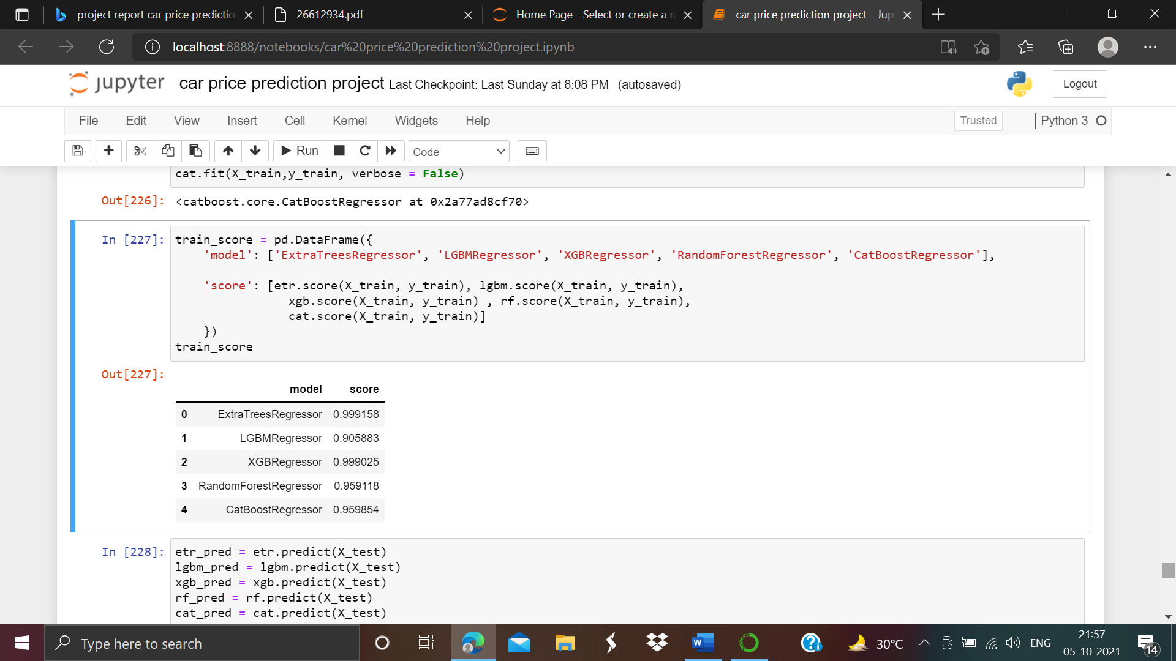
Results
The results of our tests were quantified in terms of the model score of our predictions. Model score is a statistical measure of how close the data are to the fitted regression line.

Slide 15
Results
As we can see the Extra Tree Regressor and XGB regressor are the our two models which are performing very well. Random forest regressor and Cat boost Regressor are showing the very good score as compared to LGBM regressor. Also LGBM regressor showing satisfactory results.

Slide 16
CONCLUSION
The increased prices of new cars and the financial incapability of the customers to buy them, Used Car sales are on a global increase.
Therefore, there is an urgent need for a Used Car Price Prediction system which effectively determines the worthiness of the car using a variety of features.
The proposed system will help to determine the accurate price of used car price prediction.
This paper compares 3 different algorithms for machine learning : Extra Tree Regressor, XGB Regressor, Random Forest Regressor, LGBM Regressor and Cat boost Regressor.

Slide 17
Thank you
Dinesh sharma

